Slide 1
Optical burst switching

Slide 2
Optical burst switching
Optical burst switching (OBS)
  Combines merits of optical circuit switching (OCS) & optical packet switching (OPS) while avoiding respective shortcomings
  Switching granularity at burst level allows for statistical multiplexing at lower control overhead than OPS
  Only control packets carried on one or more control wavelength channels undergo OEO conversion at each intermediate node
  Data bursts are transmitted on separate set of data wavelength channels that are all-optically switched at intermediate nodes
  OBS combines transparency of OCS with statistical multiplexing gain of OPS

Slide 3
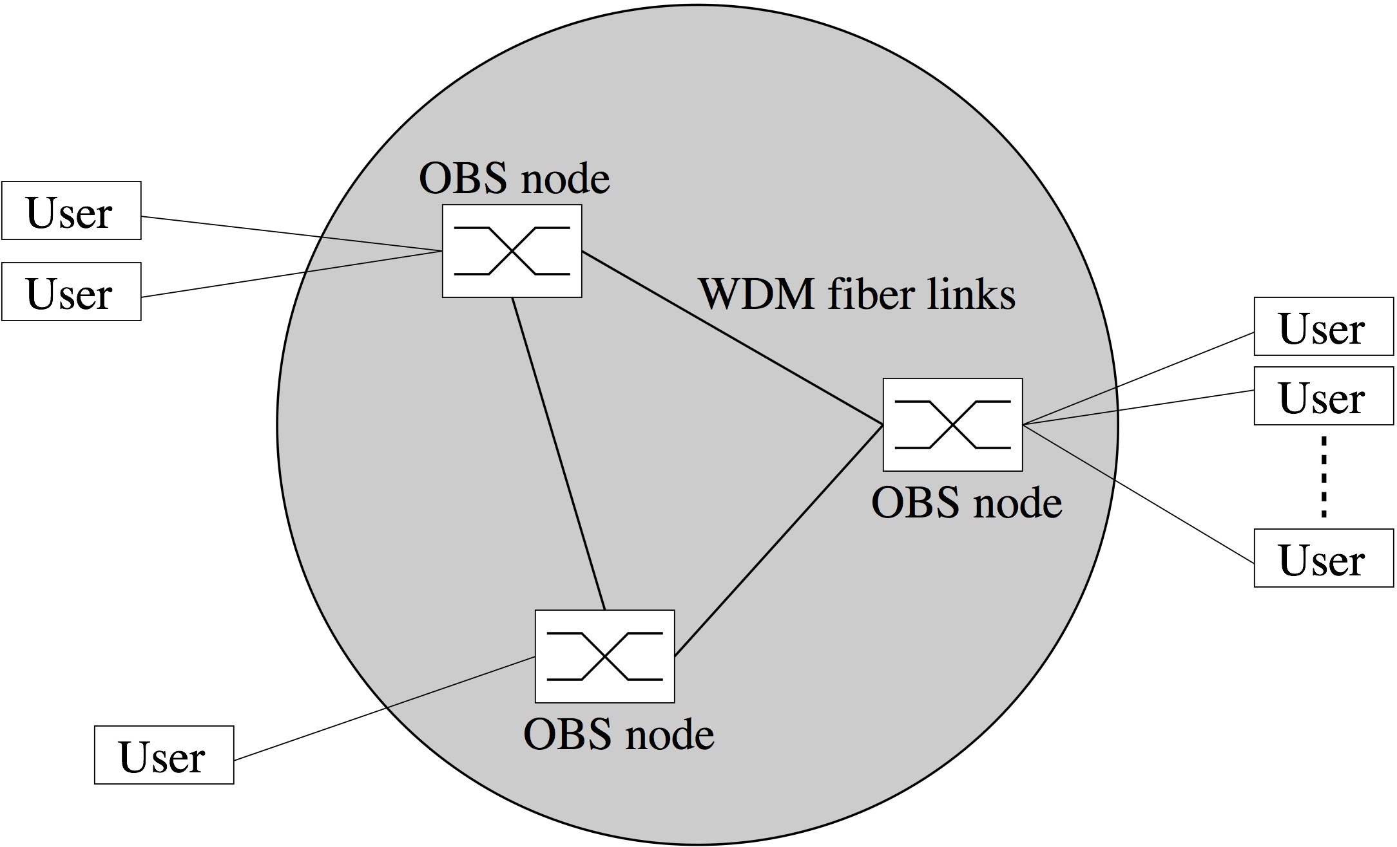
Optical burst switching
OBS framework
  OBS network edge
    One or more users (typically electronic IP routers with OBS interface) attached to an OBS node
  OBS network core
    OBS nodes interconnected by WDM fiber links

Slide 4
Optical burst switching
OBS network edge
  Edge OBS users perform the following four functions
    Burst assembly
    Signaling
    Routing & wavelength assignment
    Computation of offset time for control packet

Slide 5
Optical burst switching
Burst assembly
  OBS users
    collect traffic originating from upper layers (e.g., IP),
    sort it based on destination addresses, and
    aggregate it into variable-size bursts by using burst assembly algorithms
  Burst assembly algorithms have significant impact on performance of OBS networks & have to take the following parameters into account
    Timer
      Used by OBS user to determine when to assemble new burst
    Minimum & maximum burst size
      Determine length of assembled burst

Slide 6
Optical burst switching
Burst assembly
  Timer & burst size parameters must be set carefully
    Long bursts hold network resources for long time periods => higher burst loss
    Short bursts cause increased number of control packets => higher control overhead
  Padding may be used to assemble minimum-size burst when timer expires
  Burst assembly helps reduce degree of self-similarity of higher-layer traffic & make it less bursty => decreased queueing delay & smaller packet loss

Slide 7
Optical burst switching
Signaling
  Used to set up connection for assembled burst between given pair of source & destination edge OBS users
  OBS networks may deploy one of two types of signaling
    Distributed signaling with one-way reservation or
    Centralized signaling with end-to-end reservation
  Most of proposed OBS network architectures use distributed signaling with one-way reservation
    Source OBS user sends control packet on separate out-of-band control channel to ingress OBS node prior to transmitting corresponding burst after certain offset
    Out-of-band control channel may be dedicated signaling wavelength channel or separate control network
    Control packet contains information about burst (e.g., size)
    Control packet is OEO converted & processed in electronic domain at each intermediate OBS node

Slide 8
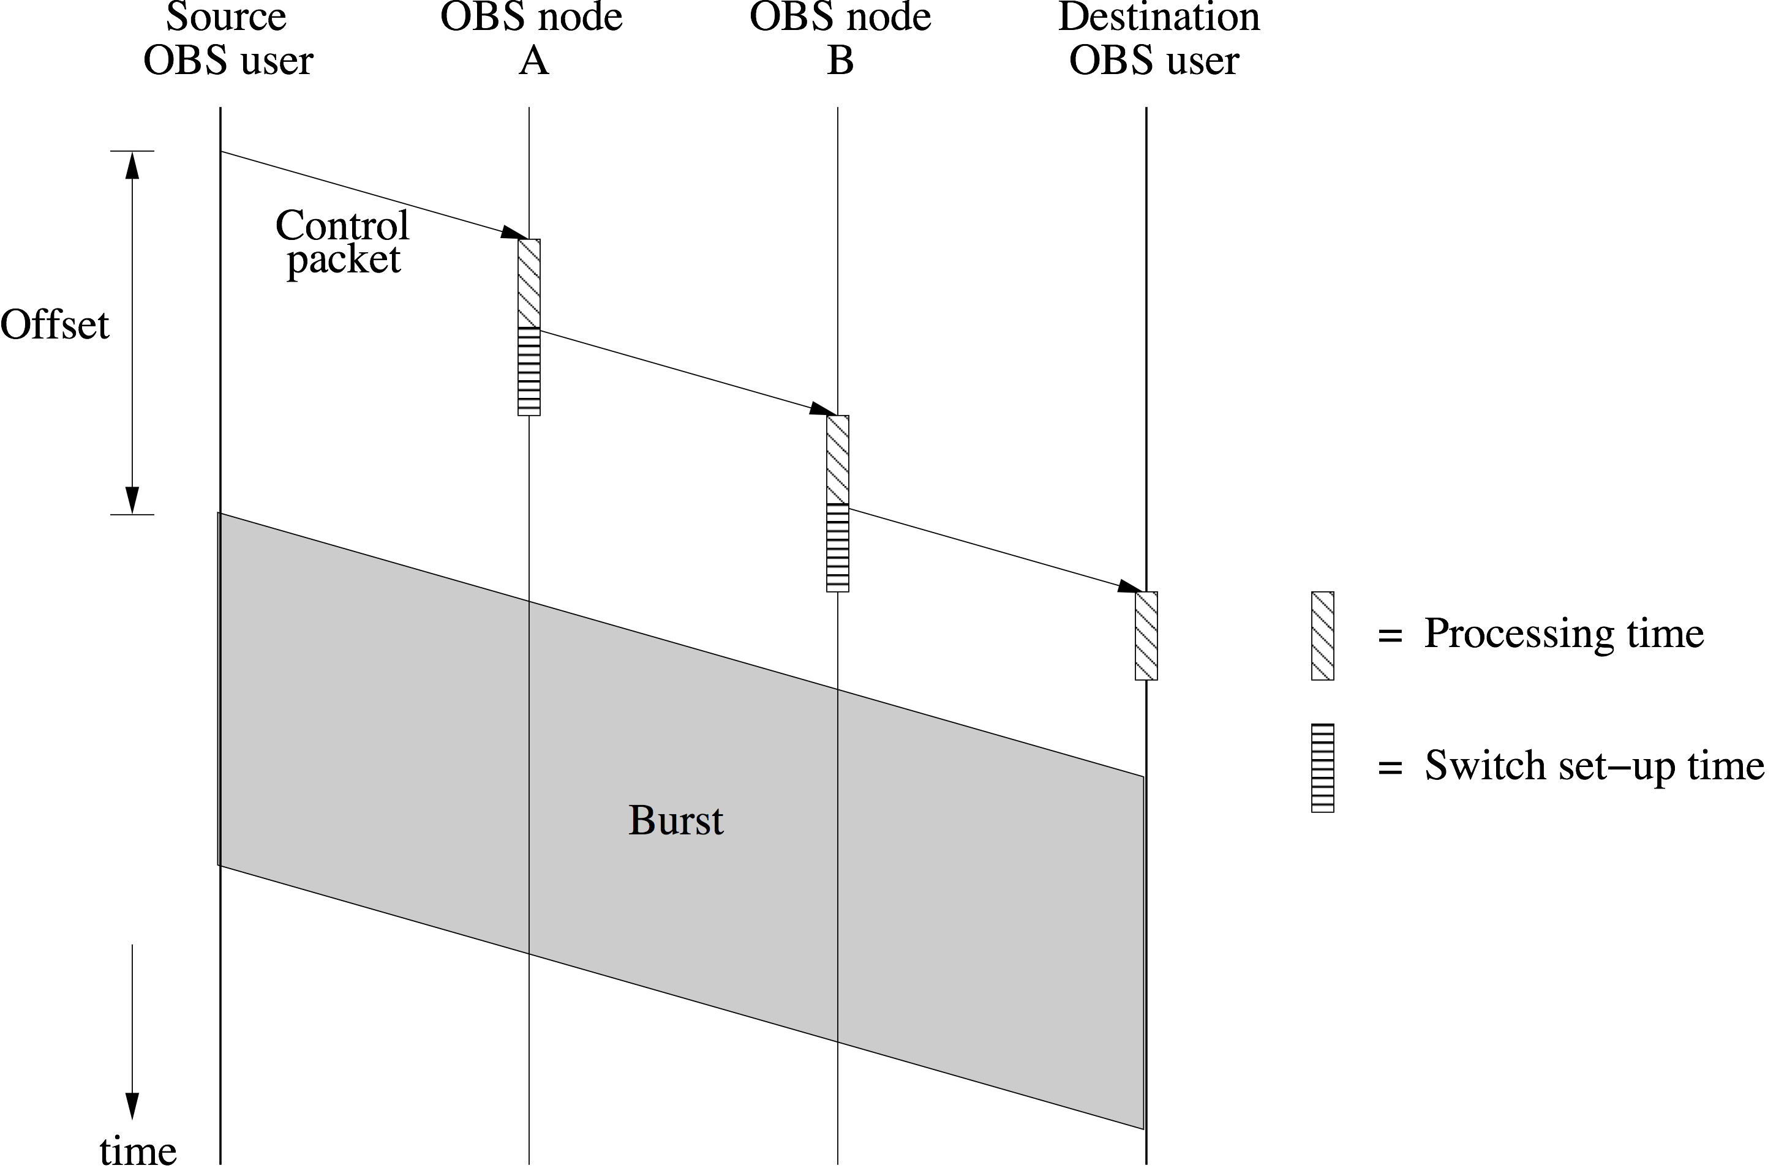
Optical burst switching
One-way reservation

Slide 9
Optical burst switching
One-way vs. two-way reservation
  In one-way reservation, burst is sent out after prespecified delay, called offset, without waiting for acknowledgment (ACK) that connection has been established
  In conventional two-way reservation, source OBS user would wait for ACK before sending any data
  Benefit of one-way reservation
    Significantly decreases connection set-up time to one-way end-to-end propagation delay plus time required to process control packet & configure optical switch fabric at intermediate OBS nodes
  Shortcoming of one-way reservation
    Nonzero burst loss probability since control packets may not be successful in setting up connections due to congestion on data wavelength channels
    Retransmission of lost bursts left to higher-layer protocols

Slide 10
Optical burst switching
End-to-end reservation
  Second less frequently used OBS signaling approach uses centralized signaling with end-to-end reservation
    OBS users send connection set-up requests to ingress OBS nodes
    Ingress OBS nodes inform central request server about set-up requests
    Based on global knowledge about current OBS network status, central server processes set-up requests & sends ACKs to requesting OBS users
    Upon receipt of ACKs, OBS users transmit bursts

Slide 11
Optical burst switching
Routing & wavelength assignment
  Routing in OBS networks can be done in two ways
    Hop-by-hop routing using fast routing table lookup algorithms at intermediate OBS nodes
    Computing explicit or constraint-based routes at edge OBS users deploying GMPLS routing protocols
  Each link along selected path must be assigned a wavelength
    Wavelength assignment with and without wavelength conversion at intermediate OBS nodes
    Wavelength conversion
      Fixed
      Limited-range
      Full-range
      Sparse

Slide 12
Optical burst switching
Offset
  After sending control packet, OBS user waits for a fixed or variable offset time until it starts to transmit data burst
  Offset lets control packet be processed, reserve resources, and configure optical switching fabric at each intermediate OBS node along selected path before burst arrives
  In case of successful reservation, arriving burst can cut through OBS nodes without buffering or processing
  Estimation & setting of offset time is crucial
  Ideally, offset estimation should take current network congestion into account & be based on number of traversed OBS nodes and involved processing and switch set-up times
  In practice, however, number of intermediate OBS nodes may not be known to source OBS user or may change over time

Slide 13
Optical burst switching
OBS network core
  OBS nodes located in core of OBS network perform the following two functions
    Scheduling of resources
    Contention resolution (if there are not enough resources)

Slide 14
Optical burst switching
Scheduling
  Based on information in control packet (e.g., offset, burst size), OBS nodes schedule local switch fabric resources
  Resource scheduling schemes
    Explicit set-up
      Wavelength reservation & switch configuration immediately after receiving & processing control packet
    Estimated set-up
      Reservation & configuration delayed until right before burst arrival time estimated using control information (offset)
    Explicit release
      Release of reserved wavelength after receiving trailing control packet sent by source OBS user
    Estimated release
      Release of reserved wavelength at burst end estimated using control information (offset and burst size)

Slide 15
Optical burst switching
Scheduling
  Four possible combinations of resource scheduling schemes
    Explicit set-up/explicit release
    Explicit set-up/estimated release
    Estimated set-up/explicit release
    Estimated set-up/estimated release
  Each combination provides different performance-complexity trade-off
    Estimated set-up/release schemes offer higher resource utilization & smaller burst loss probability than explicit counterparts
    However, explicit set-up/release schemes are simpler to implement

Slide 16
Optical burst switching
Scheduling
  Choice of resource scheduling schemes also depends on burst assembly algorithm used by edge OBS user
  Examples
    OBS user first assembles burst and then sends control packet containing offset & burst size
      => OBS nodes able to apply estimated set-up & estimated release schemes
    OBS user sends control packet before corresponding burst is assembled
      => OBS nodes have to deploy explicit release scheme

Slide 17
Optical burst switching
Contention resolution
  Contention in OBS networks occurs if
    a burst arrives at an OBS node & all local resources are occupied or
    two or more simultaneously arriving bursts contend for the same resource
  Contention resolution techniques may be applied in time, wavelength, or space domains or any combination thereof
  Examples
    Fiber delay lines (FDLs)
    Deflection routing
    Wavelength conversion

Slide 18
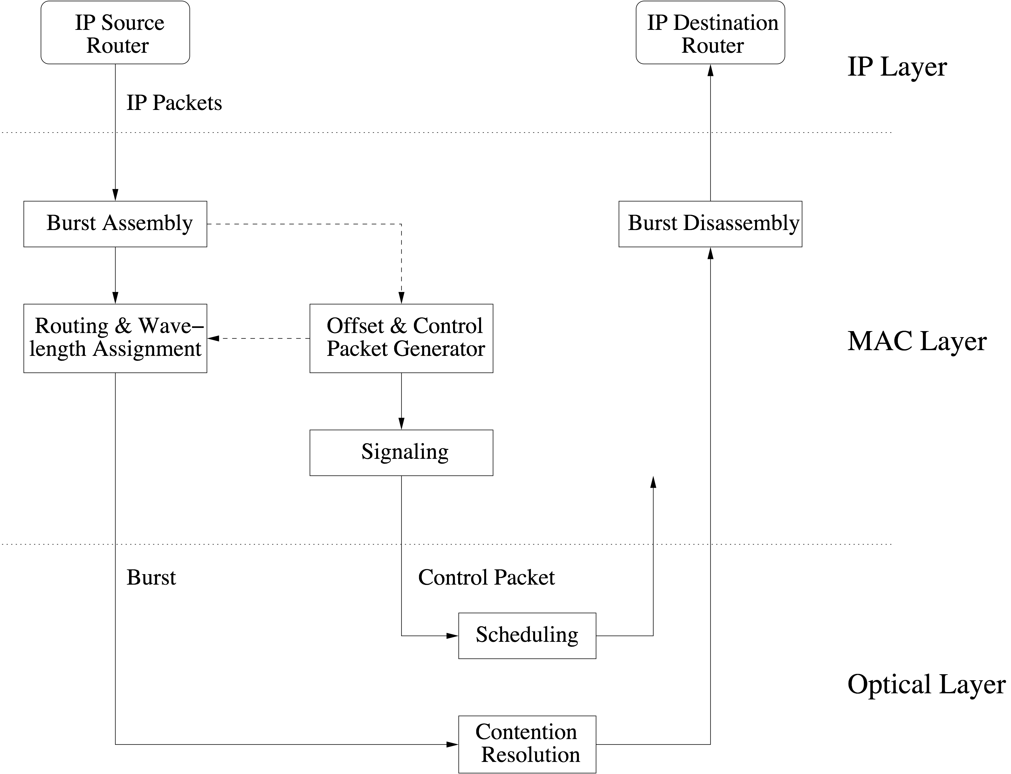
Optical burst switching
Block diagram of OBS networks

Slide 19
Optical burst switching
Burst assembly algorithms
  Help smooth input IP packet process & reduce degree of self-similarity of IP traffic => simplified traffic engineering & capacity planning of OBS networks
  Most burst assembly algorithms use either burst assembly time or burst length or both as criteria to aggregate bursts
  Typically, algorithms use the following two parameters
    Time threshold T
      Used to limit delay of buffered packets within a maximum value T under light traffic
    Burst length threshold B
      Used to launch burst transmission as soon as burst reaches or exceeds B
  Both parameters T & B are either fixed or adjusted dynamically

Slide 20
Optical burst switching
Burst assembly algorithms
  Based on thresholds T & B, burst assembly algorithms can be classified into
    Time-based assembly algorithms
    Burst length-based assembly algorithms
    Mixed time/burst length-based assembly algorithms
    Dynamic assembly algorithm
  Time-based assembly algorithms
    Fixed time threshold T used as single criterion to send out burst (i.e., burst is sent after T time units)
  Burst length-based assembly algorithms
    Fixed burst length threshold B used as single criterion to send out burst (i.e., burst is sent when it reaches or exceeds B)
  Single-criterion (time or burst length) assembly algorithms suffer from shortcomings at low and high traffic loads

Slide 21
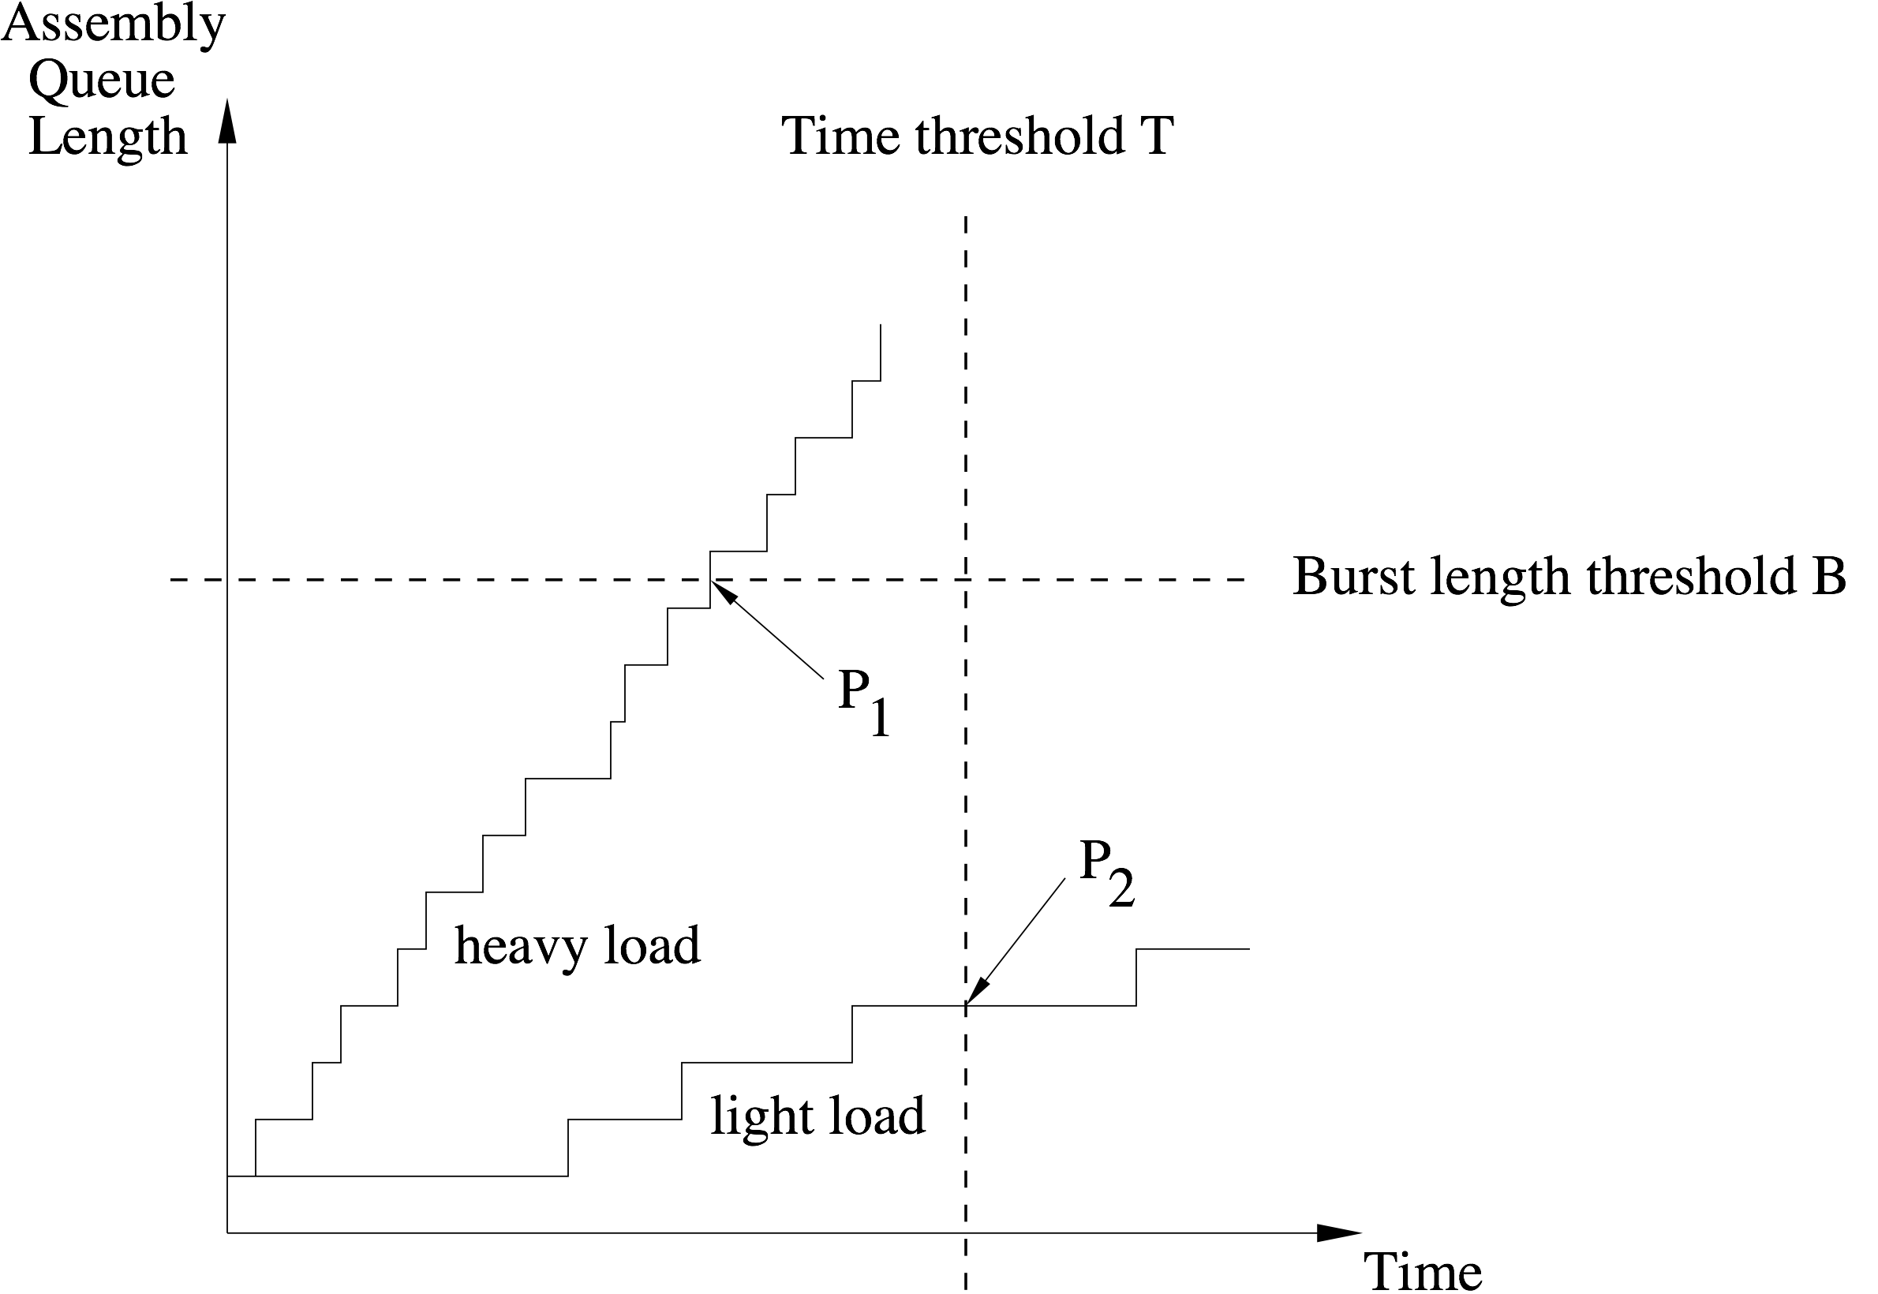
Optical burst switching
Single-criterion assembly algorithms

Slide 22
Optical burst switching
Multi-criteria assembly algorithms
  Mixed time/burst length-based assembly algorithms
    Both time threshold T & burst length threshold B used as criteria to send out burst
    Depending on traffic loads and threshold values, either threshold is crossed first & burst is transmitted
  Dynamic assembly algorithms
    Either time threshold T or burst length threshold B or both are set dynamically according to given traffic
    Dynamic (adaptive) assembly algorithms achieve improved performance at the expense of increased computational complexity compared to aforementioned assembly algorithms which use fixed (static) thresholds

Slide 23
Optical burst switching
Forward resource reservation (FRR)
  FRR deploys two performance-enhancing techniques
    Prediction of packet traffic arriving at edge OBS users
    Pretransmission of control packets
  FRR makes use of several parameters
T_{b} | Time when a new burst starts to be assembled
T_{h} | Time when corresponding control packet is sent
T_{d} | Time when burst is sent
τ_{a} | Duration of burst assembly
τ_{o} | Offset between control packet and burst

Slide 24
Optical burst switching
Forward resource reservation (FRR)
  FRR comprises following three steps
    Prediction
      As soon as previous burst is assembled, a new burst starts to be assembled at T_{b} by OBS user who predicts length of new burst based on linear prediction
    Pretransmission
      Control packet is sent out upon completion of prediction at T_{h} = max {T_{b} , T_{b} +τ_{a} -τ_{o}}
    Examination
      Upon completion of burst assembly, actual burst length is compared with predicted length carried in control packet
        If actual burst length ≤ predicted length, burst is sent at T_{d} = T_{h} + τ_{o}
        Otherwise, control packet is retransmitted at T_{b} + τ_{a} carrying actual burst length, followed by burst after τ_{o}

Slide 25
Optical burst switching
Forward resource reservation (FRR)
  Basic idea in summary
    FRR overlaps burst assembly & signaling in time in that control packet is sent prior to completion of burst assembly process
    In doing so, part of burst assembly delay can be masked to higher layers => decreased latency in OBS networks

Slide 26
Optical burst switching
Burst cluster
  The so-called burst cluster transmission technique enables service differentiation in terms of burst blocking probability
  It consists of
    a burst cluster transmission scheduling algorithm performed by edge OBS users
      Each OBS user classifies arriving IP packets according to their egress OBS nodes & then sorts them in M separate queues depending on their service classes
    and a mixed time/burst length-based assembly algorithm to form burst clusters
      Generates M bursts from queues, each burst containing IP packets of same service class
      Based on service class, M bursts are sorted in increasing order
      Sorted M bursts are put together into a burst cluster & sent out

Slide 27
Optical burst switching
Burst cluster
  Service differentiation
    Intermediate OBS node without sufficient resources drop first low-priority bursts at head of burst cluster until sufficient resources become available
    In doing so, low-priority bursts containing low-priority IP packets may be dropped while high-priority bursts/IP packets are forwarded toward egress OBS node
    As a result, low-priority bursts are subject to higher burst loss probability than high-priority bursts

Slide 28
Optical burst switching
Signaling
  Signaling in OBS networks can be done in two ways (both applying tell-and-go principle)
    Just-in-time (JIT) signaling
      OBS node configures its optical switch after receiving & processing control packet (immediate reservation)
      Easy to implement, but does not take offset into account => inefficient use of resources & increased burst loss
    Just-enough-time (JET) signaling
      OBS node makes use of offset time information & configures its optical switch right before expected arrival time of burst (delayed reservation)
      Burst length information used to enable close-ended reservation (i.e., without explicit release) => JET signaling able to make decisions about next burst scheduling & achieves higher utilization and lower burst loss than JIT

Slide 29
Optical burst switching
Scheduling
  In OBS networks, bursts generally may have different offset times & may not arrive in same order as their corresponding control packets => each wavelength likely to be fragmented with so-called void (i.e., idle) intervals
  Requirements of burst scheduling algorithms
    Able to efficiently utilize voids for scheduling newly arriving bursts & reserve bandwidth for them
    Able to process control packets fast & make efficient use of suitable void intervals

Slide 30
Optical burst switching
Scheduling algorithms
  OBS scheduling algorithms can be roughly categorized into two categories
    Non-void filling scheduling algorithms
      In general, fast but not bandwidth efficient
      Example: Horizon
    Void-filling scheduling algorithms
      In general, provide better bandwidth utilization at expense of larger computational complexity
      Example: Latest available unused channel with void filling (LAUC-VF)

Slide 31
Optical burst switching
Horizon
  Scheduler keeps track of so-called horizon of each wavelength channel
  Horizon denotes time after which no reservation has been made on a given wavelength channel
  Scheduler assigns arriving burst to wavelength channel with latest horizon as long as it is still earlier than arrival time of burst
  In doing so, void interval between horizon & starting time of reservation period is minimized
  Benefits
    Simplicity & short running time
  Drawbacks
    Low bandwidth utilization & high burst loss probability (since void intervals are not taken into account)

Slide 32
Optical burst switching
LAUC-VF
  Keeps track of all void intervals
  Assigns arriving burst a large enough void interval whose starting time is the latest but still earlier than burst arrival time
  Benefits
    Provides better bandwidth utilization & burst loss probability than Horizon
  Drawbacks
    Much longer execution time than that of Horizon

Slide 33
Optical burst switching
Service differentiation
  Approaches to achieve service differentiation in OBS networks can be applied at the network edge and/or core
  Service differentiation at OBS network edge
    OBS users deploy offset-time-based QoS scheme that uses extra offset to isolate service classes from each other
    For illustration, let’s consider two service classes, low-priority class 0 & high-priority class 1, and use delayed reservation
      Extra offset t_{o}¹ is given to class 1 traffic, but not to class 0 traffic, to give class 1 higher priority for resource reservation at core OBS nodes (normal offset set to zero)
      Let t_{a}^{i} and t_{s}^{i} denote the arrival times of control packet and corresponding data burst, respectively, for a class i request req(i), where i = 0, 1
      Furthermore, let l_{i} denote burst length requested by req(i)

Slide 34
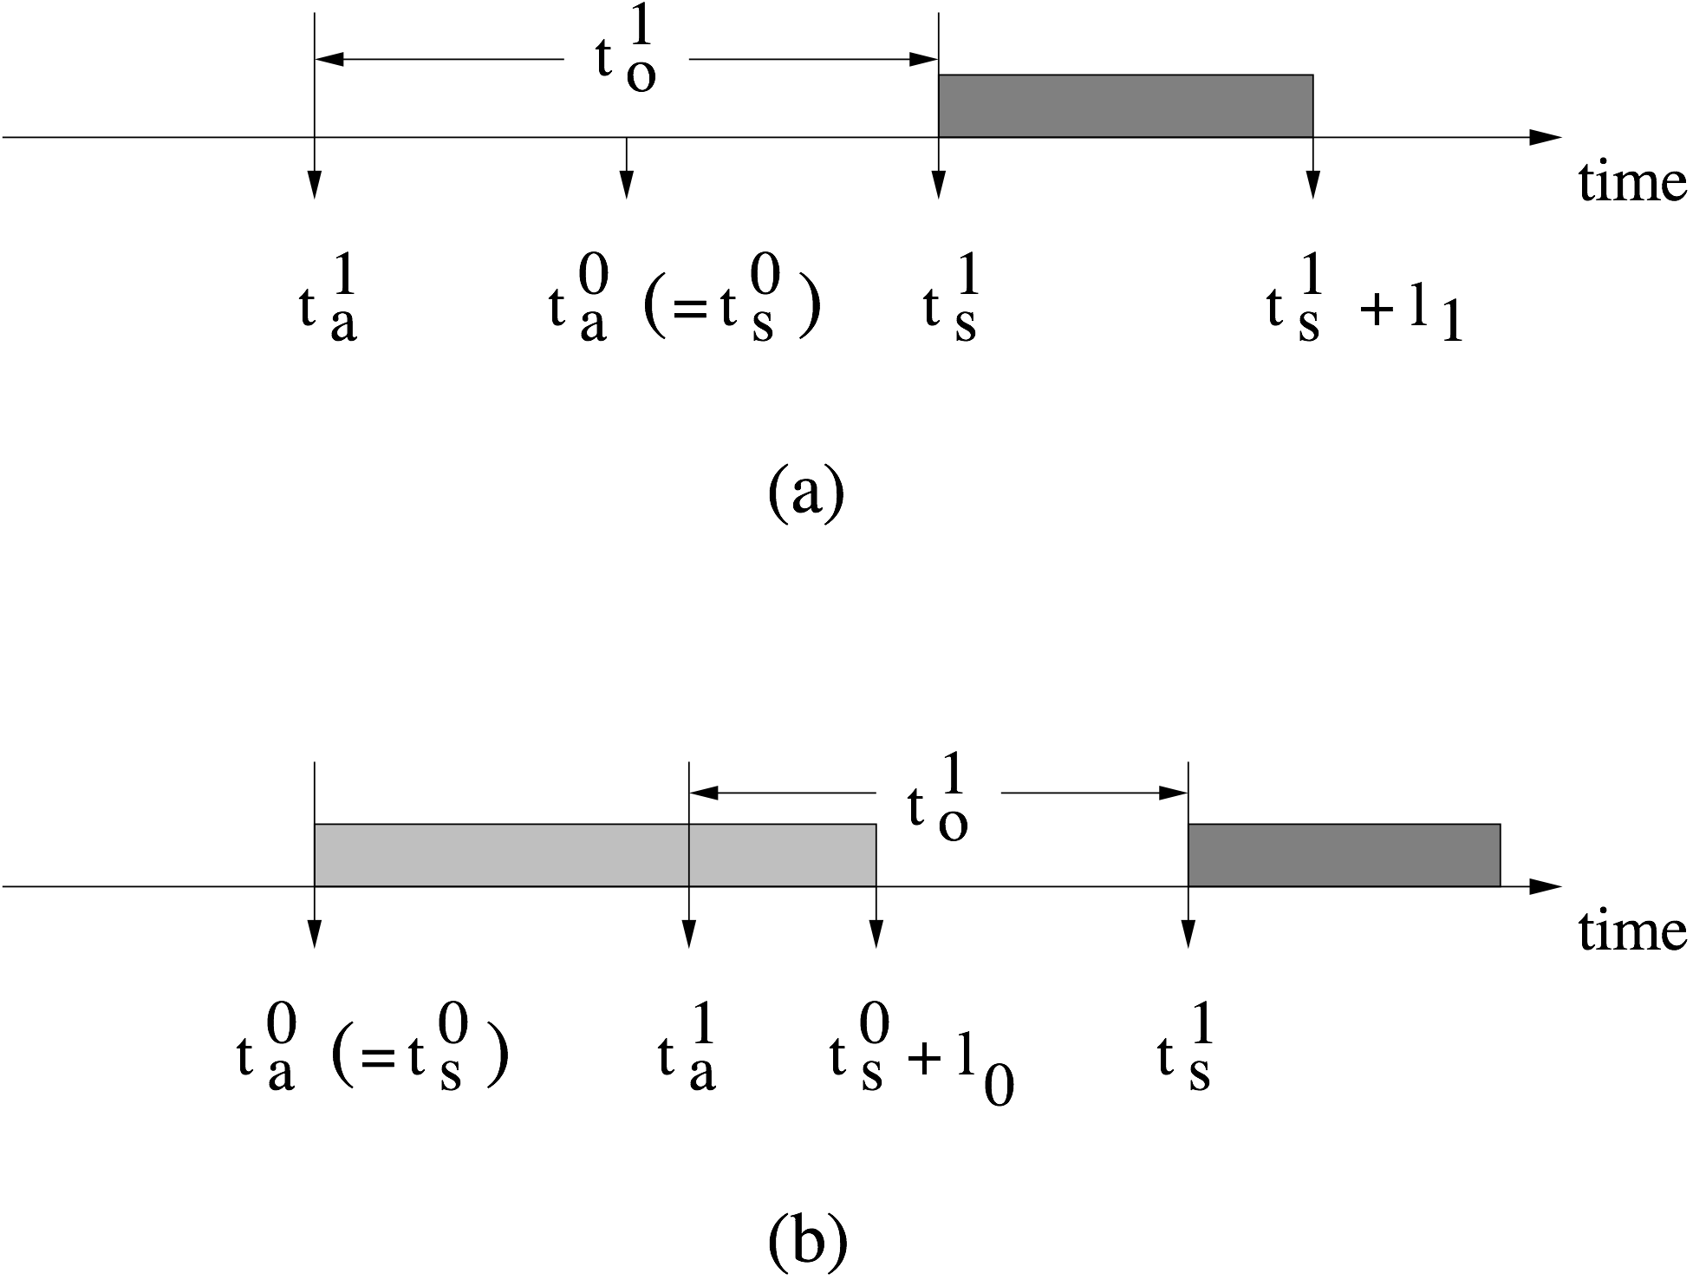
Optical burst switching
Extra-offset-based QoS scheme
  Consider two scenarios
    (a) req(1) is successful while req(0) is blocked if
    t_{a}⁰ < t_{s}¹ and t_{a}⁰ + l₀ > t_{s}¹ or t_{s}¹ < t_{a}⁰ < t_{s}¹ + l₁
    (b) req(0) & req(1) are successful if t_{s}¹ = t_{a}¹ + t_{o}¹ > t_{a}⁰ + l₀

Slide 35
Optical burst switching
Extra offset
  Importantly, extra offset of class 1 must be larger than maximum burst length of class 0 such that control packets of class 1 are not blocked by control packets of class 0
    With sufficiently large extra offset, burst blocking probability of class 1 bursts is only a function of offered class 1 load, independent of offered class 0 load
    Whereas burst blocking probability of class 0 bursts is affected by offered load of both classes 0 & 1
    Class 1 traffic can be completely isolated from class 0 traffic by setting extra offset large enough
  Partial class isolation obtained by setting extra offset to some value smaller than maximum burst length of class 0
    Useful to achieve any arbitrary degree of isolation & variable service differentiation between service classes 0 & 1

Slide 36
Optical burst switching
Extra offset for multiple classes
  Extra-offset-based QoS scheme can be easily extended to multiple service classes
    Consider two adjacent service classes i and i-1
    Let t_{diff} denote difference between extra offsets assigned to classes i and i-1
    t_{diff} must be set properly to achieve certain isolation between service classes i and i-1
      t_{diff} larger than maximum burst length of class i-1
        Class i is fully isolated from class i-1
      t_{diff} smaller than maximum burst length of class i-1
        Partial isolation of classes i and i-1
  For small number of service classes & carefully engineered burst lengths, negative impact of extra offset on end-to-end latency becomes negligible, especially for large OBS networks

Slide 37
Optical burst switching
Preemption
  Besides increased burst assembly delay, extra-offset-based QoS scheme suffers from unfairness against long bursts of low priority
    Difficult to find long gap on any wavelength at OBS node to serve long burst of low priority in almost full schedule table
    As a result, long bursts of low priority more likely dropped than short bursts belonging to same traffic class
  Wavelength preemption avoids both shortcomings of extra-offset-based QoS scheme
    OBS nodes monitor locally scheduled bandwidth allocation for each traffic class
    High-priority burst unable to be scheduled is not immediately dropped but is rescheduled in order to preempt one or more low-priority bursts that were already scheduled

Slide 38
Optical burst switching
Usage profiles
  Preemption can be used in conjunction with wavelength usage profiles in order to efficiently provide service differentiation
    Each traffic class is associated with predefined usage limit, defined as fraction of wavelength resources the class is allowed to use at intermediate OBS nodes
    Classes of higher priority allowed to use more wavelength resources than classes of lower priority
    Each OBS node monitors wavelength usage profile for each class per output link

Slide 39
Optical burst switching
Usage profiles
  Upon receiving a class i request
    OBS node attempts to find wavelength on intended output port
    If attempt succeeds, burst is scheduled & usage profile of class i is updated
    Otherwise, OBS nodes examines whether class i is in profile
      If class i is in profile, i.e., its current usage does not exceed predefined usage limit, previously scheduled burst of an out-of-profile class is preempted, starting from the class with lowest priority in ascending order to highest priority
      After preemption, OBS node updates usage profiles of both classes
      If no out-of-profile scheduled bursts can be found to preempt, class i request is rejected & burst will be dropped

Slide 40
Optical burst switching
Usage profiles
  Preemption together with usage profiles able to out-perform extra-offset-based QoS scheme in terms of burst loss probability & wavelength utilization
  Preemption-based scheme provides only relative QoS
    Performance of each class is not specified in absolute terms
    Instead, QoS of each class defined relatively with respect to other classes
    Actual QoS performance, e.g., burst loss probability, depends on traffic loads of low-priority class
    Thus, no upper bound on burst loss probability can be guaranteed for high-priority class

Slide 41
Optical burst switching
Early dropping
  Early dropping achieves service differentiation with absolute QoS by probabilistically dropping low-priority bursts in order to guarantee prespecified burst loss probability of high-priority traffic
  Similar to random early detection (RED) used by routers to avoid congestion in packet-switched networks
    In RED, router detects congestion by monitoring average queue size
    RED cannot be directly applied to OBS networks due to their inherently bufferless nature
    Therefore, early dropping mechanism must be modified to be suitable for OBS networks

Slide 42
Optical burst switching
Early dropping
  Early dropping monitors burst loss probability rather than average queue size by means of online measurements
    OBS node computes early dropping probability p_{i}^{ED} for each traffic class i based on online measured burst loss probability & maximum burst loss probability of next higher traffic class i-1
    In addition, early dropping flag e_{i} is associated with each class i, where e_{i} is determined by generating random number between 0 and 1
      If generated number < p_{i}^{ED}, then e_{i} is set to 1
      Otherwise, e_{i} is set to 0
    To decide whether or not to drop arriving class i burst, OBS node considers not only e_{i} but also e_{j} of all higher-priority classes j = 1, …, i-1
    OBS node drops class i burst if e₁ ∨ e₂ ∨ ••• ∨ e_{i} = 1

Slide 43
Optical burst switching
Contention resolution
  Contention in OBS networks occurs when two or more bursts arriving at a given intermediate OBS node request the same resources at the same time
  Several techniques exist to resolve contention at intermediate OBS nodes
  Beside contention resolution, these techniques can also be deployed to enable service differentiation by taking different service classes of contending bursts into account & giving bursts belonging to a higher service class priority over lower-class bursts

Slide 44
Optical burst switching
Fiber delay lines
  Contention in OBS networks can be resolved by using either fixed fiber delay lines (FDLs) or switched delay lines (SDLs) at OBS nodes
    SDLs make use of 2x2 space switches & are able to provide variable-delay buffering
    SDLs add another dimension to wavelength reservation => two-dimension reservation scheme
      Phase 1: wavelength reservation
      Phase 2: SDL buffer reservation
    SDL buffer reservation implies that scheduler knows both arrival time & departure time of incoming burst in order to compute required delay value
    Contending burst is dropped if no SDL with appropriate delay is available at burst arrival time

Slide 45
Optical burst switching
SDL vs. electronic buffer
  Electronic buffer can store bursts for any arbitrary time period
  In contrast, SDL (and FDL)
    is able to store burst only for a fixed maximum period of time & thus provides deterministic delay
    exhibits so-called balking property
      Incoming burst must be dropped if maximum delay provided by SDL is not sufficient to store incoming burst & avoid contention with burst that is currently being transmitted on a given output port
  Use of SDLs decreases burst loss probability of OBS networks for increasing length B of SDLs
    For increasing B, more contending bursts can be temporarily stored (at the expense of increased queueing delay)
    Performance gain diminishes quickly after certain threshold

Slide 46
Optical burst switching
Burst segmentation
  With burst segmentation, it is possible to drop only those parts of the burst which overlap with other contending bursts
  In doing so, parts of the burst & all IP packets carried in those parts can be successfully forwarded => improved packet loss probability of OBS networks
  Burst segmentation was first considered in the context of the so-called optical composite burst switching (OCBS) paradigm

Slide 47
Optical burst switching
OCBS
  In traditional OBS networks, entire burst is discarded when all wavelengths at a given output port are occupied at burst arrival time
  In contrast, in OCBS
    Burst is forwarded by core OBS node if any wave-length channel is available at burst arrival time by using wavelength conversion
    Otherwise, core OBS node discards only the initial part of arriving burst until a wavelength becomes free at output port on which remainder of burst can be forwarded
    Entire burst is lost if no wavelength channel becomes available before burst departure time

Slide 48
Optical burst switching
Dropping policies
  In burst segmentation, burst is generally divided into transport units called segments
  Each segment may contain single IP packet or multiple IP packets
  Boundaries of each segment represent possible partitioning points of burst when parts of burst must be dropped
  In event of contention, OBS node must know which of the contending burst segments will be dropped
  Two possible burst segment dropping policies exist
    Tail dropping
    Head dropping

Slide 49
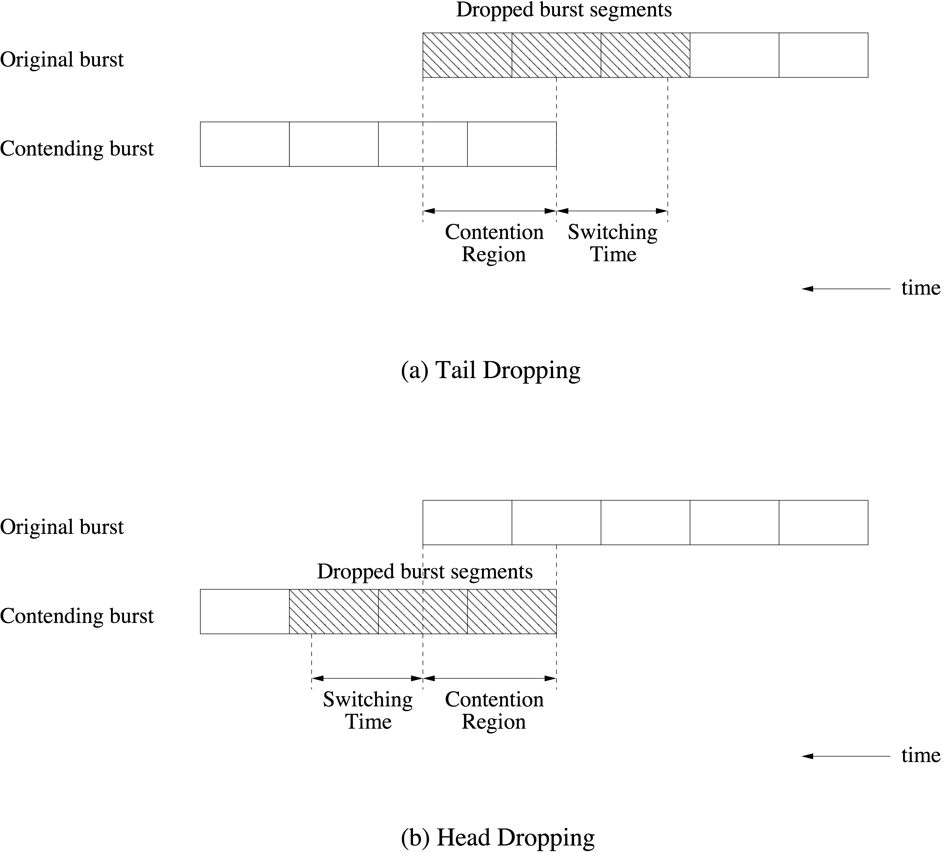
Optical burst switching
Tail vs. head
dropping

Slide 50
Optical burst switching
Prioritized burst segmentation
  Apart from resolving contention & reducing packet loss, prioritized burst segmentation allows for service differentiation without requiring any extra offset time
  Makes use of so-called composite burst assembly
    Based on tail dropping since it is superior to head dropping with respect to in-order packet delivery
    With tail dropping, packets toward tail of burst are more likely to be dropped than packets at head of burst
    Correspondingly, packets are placed in a single burst in descending order according to their traffic classes
    Bursts are assigned different priorities based on traffic classes of assembled packets (burst priorities are put in control packets)
    OBS nodes use priorities to differentiate bursts with respect to tail dropping by letting high-priority bursts preempt low-priority bursts

Slide 51
Optical burst switching
Prioritized burst segmentation
  To minimize burst/packet loss, prioritized burst segmentation can be done in conjunction with deflection routing
    Rather than dropping the tail segment of burst, either entire burst or only trail can be deflected
    Deflection routing increases probability that a burst’s packets will reach destination
    To do so, at each OBS node one or more alternate deflection ports & routes must be specified for each destination
    With prioritized burst segmentation, high-priority bursts have significantly lower packet loss & delay than low-priority bursts
    Incorporating deflection routing tends to improve performance compared to limited deflection or no deflection at all

Slide 52
Optical burst switching
Deflection routing
  Can be deployed together with burst segmentation & other contention resolution techniques (e.g., FDLs)
  Deflection routing with no optical buffering is referred to as hot-potato routing
    Contending packet is forwarded immediately through another port without being stored
    Selection of output port usually made using local information (e.g., output port with lowest delay)
    Alternatively, output ports are selected based on preassigned port priorities
  Deflection routing is triggered by OBS node using local status information of its own resources, leading to sub-optimal network performance
  Deflection routing can be improved by using so-called contention-based limited deflection routing (CLDR) protocol

Slide 53
Optical burst switching
CLDR
  In CLDR, all OBS nodes periodically exchange local status information about traffic load, burst contention rate, burst blocking probability, etc., by using, for example, GMPLS OSPF/IS-IS routing protocols with appropriate TE extensions
  CLDR algorithm runs at all OBS nodes & sequentially performs the following two steps
    Deflection routing vs. retransmission decision
    Alternate path selection

Slide 54
Optical burst switching
CLDR
  Step 1: Deflection routing vs. retransmission decision
    OBS node dynamically determines whether arriving burst is deflection routed or dropped
    In the latter case, dropped burst needs to be retransmitted by corresponding source OBS user
    Decision between deflection routing & retransmission is checked against threshold function with two (weighted) variables
      Traversed hop-count of arriving burst
      Burst blocking probability of all available paths
    Rationale behind threshold function
      At low traffic loads: Deflection routing should be performed
      At high traffic loads: Burst retransmission is more suitable
      At medium traffic loads: Deflection routing or retransmission might be given higher priority, depending on chosen weights

Slide 55
Optical burst switching
CLDR
  Step 2: Alternate path selection
    This step applies only if contending burst was not dropped
    Using deflection routing, burst is sent along alternate path that minimizes cost function
    Cost function is weighted sum of end-to-end burst blocking probability & distance of route
    In general, selected alternate path is not necessarily shortest path

Slide 56
Optical burst switching
CLDR
  CLDR is able to avoid injudicious deflection routing in OBS networks by using threshold-based dynamic decision algorithm
  Importantly, in CLDR (and any other deflection routing scheme) for bursts to arrive successfully at their destination over alternate routes, which are generally longer than the primary path, two solutions exist
    Source OBS user adds sufficiently large extra offset time to control packet
    Alternatively, control packet reserves FDL buffer to delay subsequent burst at OBS node for sufficiently long time period

Slide 57
Optical burst switching
Wavelength conversion
  Powerful tool to resolve contention in OBS networks
  In practical OBS networks, however, only limited-range and sparse wavelength conversion appears technically feasible & affordable, at the expense of increased contention
  Wavelength conversion may be used in combination with other contention resolution techniques (e.g., FDLs, burst segmentation)
  Alternatively, careful wavelength assignment to bursts by edge OBS users is able to mitigate contention in OBS networks
    Adaptive & nonadaptive wavelength assignment heuristics exist without requiring any other contention resolution technique
    Intelligent choices have significant impact on burst loss probability
    Results show that best performing heuristics improve burst loss probability by two order of magnitude compared to rather simple random & first-fit wavelength assignments heuristics

Slide 58
Optical burst switching
Multicasting
  To support multicasting in OBS networks, OBS nodes must be able to split incoming optical signal to multiple output ports by using optical splitters
  Optical splitters may be used by either all OBS nodes or only subset of OBS nodes => sparse splitting
  Number & location of splitting capable OBS nodes have impact on construction of multicast trees in OBS networks
  Several multicasting approaches were proposed for OBS networks
    Separate multicast (S-MCAST)
    Multiple unicast (M-UCAST)
    Tree-shared multicast (TS-MCAST)

Slide 59
Optical burst switching
S-MCAST
  For each multicast session, every OBS user maintains a separate burst assembly queue & constructs its own source-specific multicast tree
  Each source OBS user assembles multicast traffic of a given multicast session into multicast bursts
  After burst assembly time is over, multicast burst is sent on multicast tree to all destination OBS nodes belonging to the multicast group
  In S-MCAST, multicast traffic is sent independent from unicast traffic

Slide 60
Optical burst switching
M-UCAST
  In M-UCAST, multicast traffic is treated as unicast traffic
    Source OBS user makes multiple copies of arriving multicast packet, one copy for each multicast group member
    Source OBS user assembles copies along with unicast packets destined to the same OBS user into unicast bursts
    Assembled unicast bursts are delivered to correspond-ing destination OBS users by means of unicasting
    Control overhead in M-UCAST is reduced since no separate control packets are needed for multicast bursts

Slide 61
Optical burst switching
TS-MCAST
  In TS-MCAST, multicast sessions originating from same source OBS user are decomposed into disjoint subsets according to a given tree sharing algorithm
  Each disjoint subset is called a multicast sharing class (MSC)
  A source OBS user deploys a single multicast burst assembly queue for each MSC
  Each assembled multicast burst for an MSC is sent along a shared tree, which can be a multicast tree in MSC or a newly constructed multicast tree
    With tree sharing, multiple multicast sessions use a single shared tree for delivery of their multicast packets
    Due to tree sharing average multicast burst length is longer than in S-MCAST => reduced control overhead
  Unicast traffic is treated separately from multicast traffic

Slide 62
Optical burst switching
Tree-sharing strategies
  To from an MSC, OBS user adopts one of the following three tree-sharing strategies
    Perfect overlap
      Groups all multicast sessions with same multicast group members (i.e., same destination OBS users) into one MSC
    Super overlap
      Groups a number of multicast sessions whose multicast group members do not need to be exactly the same
    Arbitrary overlap
      Groups multiple multicast sessions that have sufficient overlap in terms of multicast destination OBS users, core OBS nodes, or links on their multicast trees
      To decide whether there is sufficient overlap, the calculation of the degree of overlap must be defined

Slide 63
Optical burst switching
Degree of overlap
  Degree of overlap of multiple, say, s multicast sessions in terms of destination OBS users can be defined as follows
    For each destination OBS user, e, a fractional number d_{e} ≤ 1 is calculated by dividing number of multicast sessions with group member e by total number s of multicast sessions
    Degree of overlap of multicast sessions is calculated by taking the sum of all d_{e} & dividing the sum by number of all destination OBS users belonging to the s multicast sessions
  The degree of overlap in terms of core OBS nodes & links can be calculated in a similar fashion
  A source OBS user selects the subset of multicast sessions that has the highest degree of overlap in terms of destination OBS users, core OBS nodes, and/or links

Slide 64
Optical burst switching
TS-MCAST vs. S-MCAST & M-UCAST
  Performance comparison study of TS-MCAST, S-MCAST, and M-UCAST under same unicast traffic load with static multicast sessions & multicast group membership
  Obtained results show that TS-MCAST outperforms S-MCAST & M-UCAST in terms of bandwidth efficiency & control overhead (i.e., number of control packets)

Slide 65
Optical burst switching
Protection
  Protection schemes proposed for OBS networks can be roughly classified into
    1+1 path protection switching
      Done by source & destination edge OBS users
      Does not require any modification or special functionality at intermediate core OBS nodes
    Segment protection switching
      Performed by intermediate core OBS nodes

Slide 66
Optical burst switching
1+1 path protection switching
  Extension of GMPLS 1+1 protection switching to OBS networks
  Applicable only in context of a session
    A session denotes a persistent route connection between pair of source & destination OBS users
    All bursts associated with a given session follow same route from source OBS user to destination OBS user
  To achieve this, output ports at all traversed OBS nodes are reserved to pin down path
  After computing & pinning down two disjoint paths, source OBS user duplicates each burst, assigns both bursts separate control packet, and sends them along both paths
  Destination OBS uses a selector (e.g., OSNR) to choose best signal & switches over to other signal if selected path fails or degrades

Slide 67
Optical burst switching
Segment protection switching
  Apart from contention resolution, deflection routing & burst segmentation can be deployed for protection in OBS networks
    Deflection routing
      Upon failure detection, OBS node immediately upstream from failure sends bursts destined for affected output port to other output ports
    Burst segmentation
      OBS node can use deflection routing in combination with burst segmentation to reduce packet loss due to OBS network failures

Slide 68
Optical burst switching
OBS derivatives
  Several suggestions made to extend functionality of OBS
  Most important OBS derivatives are
    Labeled OBS (LOBS)
    Wavelength-routed OBS (WR-OBS)
    Dual-header OBS (DOBS)

Slide 69
Optical burst switching
LOBS
  Issues with deflection routing
    In the event of contention or network failure, deflection routing prevents both control packet & data burst from being dropped
    If alternate path has many more hops than original path, deflection routed data burst might overtake its control packet due to the fact that offset time does not cover total processing delays of control packet at intermediate OBS nodes with no or not sufficient FDLs to delay data burst
    To avoid such a situation, OBS network resources (e.g., alternate paths) must be carefully engineered, which can be done by using GMPLS => labeled OBS (LOBS)

Slide 70
Optical burst switching
LOBS
  OBS is extended to LOBS by augmenting each OBS node with a GMPLS-based controller
  LOBS node similar to LSR of conventional GMPLS networks
  Explicit & constraint-based GMPLS routing protocols used for pinning down routes & traffic engineering in LOBS networks
  In LOBS, control packet containing a label & data burst are sent along preestablished LOBS path, similar to LSP
  LOBS allows bursts belonging to two or more LOBS paths to be aggregated without undergoing OEO conversion at LOBS nodes
  Edge LOBS user performs not only burst assembly but also GMPLS-related functions such as (electronic) label stacking & LSP aggregation over LOBS path

Slide 71
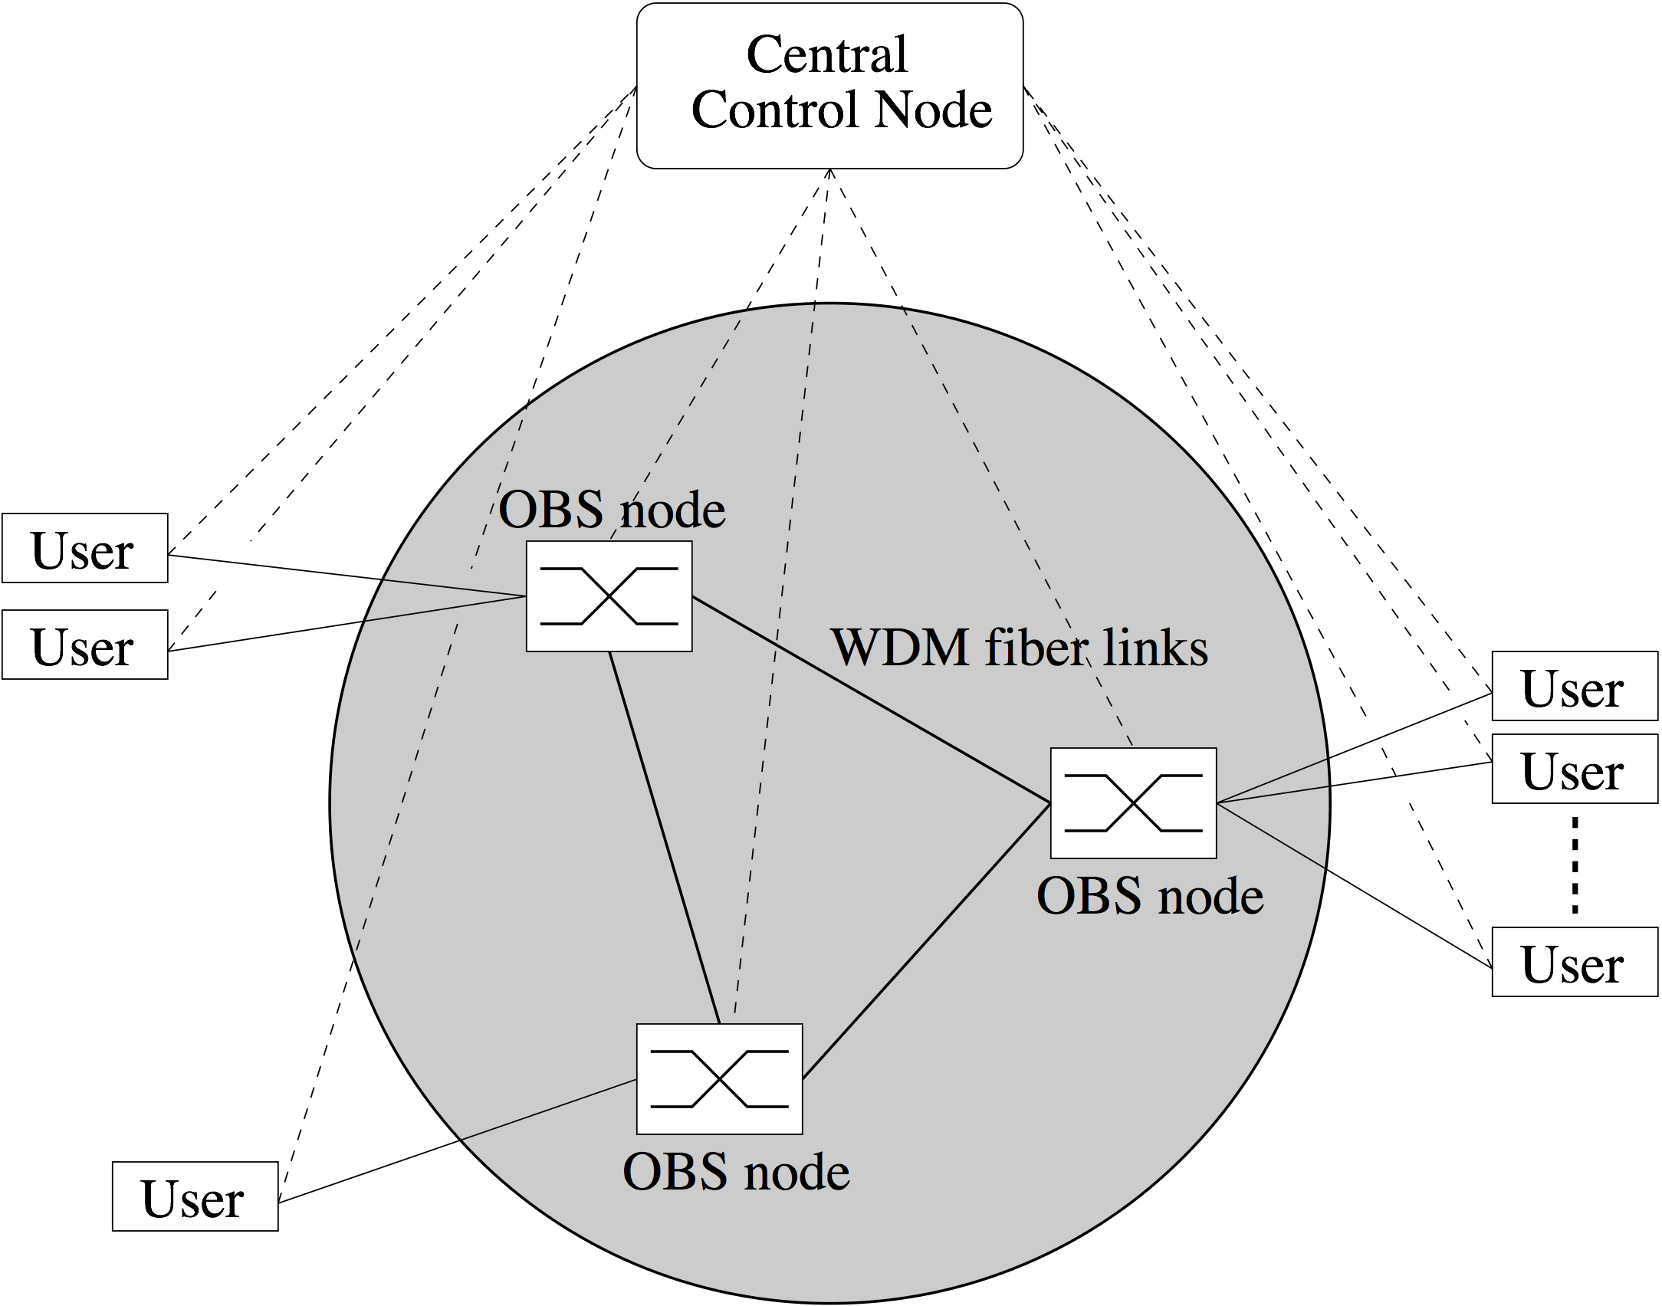
Optical burst switching
WR-OBS
  Wavelength-routed OBS (WR-OBS) combines OBS with centralized dynamic wavelength allocation

Slide 72
Optical burst switching
WR-OBS
  WR-OBS may be viewed as fast circuit switching technique
  Unlike OBS, WR-OBS uses two-way reservation mechanism with ACK between each OBS user & central control node for dynamic set-up of end-to-end lightpaths
    After assembling burst, edge OBS user requests end-to-end wavelength channel from central control node
    Upon reception of request, central node executes RWA algorithm to assign free wavelength channel & sends ACK to source OBS user to inform it about assigned wavelength channel
    After receiving ACK, source OBS user starts transmitting burst on assigned wavelength channel
    After burst transmission, wavelength channel is released

Slide 73
Optical burst switching
WR-OBS
  Pros
    Provides benefits of circuit-switched networks
      Established lightpath offers deterministic end-to-end delay equal to end-to-end propagation delay
      No further delays arising from contention
  Cons
    Larger control overhead than conventional OBS
      One control packet per request & ACK between edge OBS user & central node
      In addition, several control packets from central control node to core OBS nodes for switch configuration
    Small wavelength utilization
      Reserved wavelength is idle & not used for data burst transmission for time period t_{idle} = t_{prop,ack} + t_{prop,network}
      Suitable for metro & regional networks

Slide 74
Optical burst switching
Prebooking
  To improve wavelength utilization of large WR-OBS networks, prebooking mechanism can be deployed
    Excludes t_{prop,ack} from t_{idle}
    Makes use of estimated traffic information to proactively reserve wavelength resources
    Source OBS user initializes lightpath prebooking request at beginning (instead of end) of burst aggregation => burst assembly & RWA execution are overlapped in time
    Request includes earliest burst transmission time, maximum tolerable burst assembly delay, and predicted burst length
    Central control node receives & processes request and sends a prebooking ACK back to source OBS user
    Burst transmission takes place on assigned wavelength during allocated reservation time window

Slide 75
Optical burst switching
DOBS
  In conventional OBS networks, offsets are of variable size & vary as a function of their path lengths
  Offset variability complicates burst scheduling at intermediate OBS nodes & may lead to decreased network performance
  Dual-header optical burst switching (DOBS) avoids these complexity & performance issues by enabling core OBS nodes to precisely control offsets without requiring any FDLs
  In OBS networks using either JIT or JET signaling, bursts are immediately scheduled as soon as control packets arrive at OBS node (albeit delayed reservation is deployed in JET)
  Instead of immediate scheduling, DOBS deploys delayed scheduling by separating the control information of each burst into two control packets & decoupling resource request and scheduling operations at OBS nodes

Slide 76
Optical burst switching
DOBS
  Apart from reduced scheduling complexity & improved network performance, DOBS helps mitigate unfairness in JET signaling-based OBS networks
    Path-length unfairness
      Bursts with longer offsets experience less blocking than bursts with smaller offsets
      Burst loss probability is function of path length
      Bursts close to destination OBS users face higher loss probability than bursts far from their destinations
    Burst-length unfairness
      With void-filling scheduling algorithms, burst loss probability is generally increasing function of burst length
      Disadvantageous also in terms of throughput
  Note that JIT-based OBS networks using immediate reserv-ation do not suffer from path-length & burst-length unfairness

Slide 77
Optical burst switching
DOBS signaling
  For each burst, DOBS signaling uses two types of control packets
    Service request packet (SRP)
      Contains information about service requirements of burst (e.g., routing & class-of-service (CoS) information) as well as offset & length of corresponding burst
      Single persistent SRP precedes burst along its path
    Resources allocated packet (RAP)
      Contains additional physical information about burst (e.g., assigned wavelength channel)

Slide 78
Optical burst switching
Delayed scheduling
  SRP is processed immediately after arriving at OBS node i to determine required resources of corresponding burst
  Resource request is communicated to burst scheduler module at OBS node i
  SRP is immediately forwarded to downstream OBS node i+1 without waiting for burst scheduling operation to be executed at OBS node i => delayed scheduling
  Burst scheduling algorithm is executed at OBS node i sometime later at time t_{BS}^{i} after sending SRP but prior to burst arrival
  After completing burst scheduling, OBS node i transmits a RAP downstream to inform OBS node i+1 about wavelength channel assigned to burst

Slide 79
Optical burst switching
Scheduling offset
  After receiving in turn RAP from upstream OBS node i-1 & using result of its burst scheduling algorithm executed at time t_{BS}^{i}, OBS node i configures its optical switch fabric just before burst from OBS node i-1 arrives at time t_{b}^{i}
  Similar to OBS, offset between SRP & burst shrinks
  However, so-called scheduling offset Ω_{BS}^{i} = t_{b}^{i} – t_{BS}^{i} can be chosen arbitrarily at OBS node i & all other nodes within certain range
  In DOBS, OBS nodes have complete control over order in which arriving bursts are processed since service order of bursts is function of their scheduling offset sizes
  Ability to independently select scheduling offset at each OBS node can be exploited in several ways, e.g., OBS node may select larger Ω_{BS} to accommodate slow fabric switching time

Slide 80
Optical burst switching
CSO DOBS
  Constant-scheduling-offset (CSO) DOBS is a possible DOBS variant
  In CSO DOBS, each network link is associated with a CSO value
  By setting Ω_{BS} of a given link to a fixed value, CSO DOBS ensures that all arriving bursts have same offset & can be scheduled in FCFS manner
  Benefits of CSO DOBS
    Same low scheduling complexity as JIT signaling
    Improved throughput-delay performance compared to both JIT & JET signaling
    Unlike JET signaling, there is no burst-length unfairness since useful voids are not created during burst scheduling
    Path-length unfairness is avoided since scheduling offset size is generally not a function of path length

Slide 81
Optical burst switching
Implementation
  Part of previously described functions of OBS networks were experimentally verified with particular focus on
    JIT signaling
    Wavelength assignment & deflection routing
    Labeled OBS (LOBS)

Slide 82
Optical burst switching
Implementation
  JIT signaling
    Multiwavelength optical networking (MONET) testbed
      Demonstration of software prototype of JIT signaling
      JIT signaling on bidirectional ATM-based control channel referred to as data communication network (DCN) implemented on ITU-T optical supervisory channel (OSC) @ 1510 nm
      Signaling scenarios under consideration
        Connection establishment
        Connection tear-down
        Connection failure due to request rejection
        Connection failure due to message loss

Slide 83
Optical burst switching
Implementation
  JIT signaling
    JIT signaling on control wavelength channel @ 1310 nm
      One core OBS node & three edge OBS users which use time-based burst assembly algorithm
      Reservation & release of wavelength resources at core OBS node and retransmission of failed control packets
        Edge OBS user explicitly releases wavelength resources by sending so-called burst end packet (BEP) after data burst along same path
        After receiving BEP, destination OBS user returns so-called BEP-ACK on reverse path to release reserved wavelength resources => reverse deletion
        In case of lost BEP or BEP-ACK, timer used at source OBS user to retransmit BEP

Slide 84
Optical burst switching
Implementation
  JIT signaling
    JumpStart
      JumpStart supports ultrafast lightpath provisioning by implementing JIT signaling in hardware
      Dynamic lightpath set-up initiated by operator, user, application, or protocol

Slide 85
Optical burst switching
Implementation
  Wavelength assignment & deflection routing
    OBS network testbed where edge OBS users deploy mixed time/burst length-based assembly algorithm which classifies packets by destination & CoS
    Contention resolution scheme combines deflection routing at core OBS node with priority-based wavelength assignment (PWA) at edge OBS user
      In PWA, source OBS user assigns wavelength with highest priority to assembled burst
      Priority of each wavelength channel is dynamically updated according to wavelength utilization history
      Bursts experiencing congestion at intermediate OBS node are deflection routed
      Results show that deflection routing is more effective than PWA in reducing burst loss probability

Slide 86
Optical burst switching
Implementation
  Labeled OBS (LOBS)
    Demonstration of new concept of optically labeling bursts
    Optical label & corresponding burst are modulated orthogonally to each other on same wavelength by using different modulation schemes
    Optical label swapping is done by first erasing incoming label & then inserting new outgoing label by using wavelength converters & electro-absorption modulators (EAMs), respectively

Slide 87
Optical burst switching
Application
  OBS can be used to support various applications
    In JumpStart, OBS is used to realize dynamic lightpath set-up for uncompressed HDTV, Grid applications, file transfers without requiring transport-layer sequence numbering & reassembly, and low-latency, low-jittery supercomputing applications (e.g., interactive visualization of high-volume imagery)
    Consumer-oriented Grids (e.g., multimedia editing application for manipulating video clips, add effects, restore films, etc.)
    Given that advances in recording, visualization, and effects technology will demand more computational & storage capacity which may not be locally available, OBS can be used to deliver bursts containing multimedia material to remote site with sufficient resources

